Slide 1
8086 System Bus Architecture
Abhinav Ramnath

Slide 2
8086 Microprocessor
The 8086 microprocessor is an 8-bit/16-bit microprocessor designed by Intel in the late 1970s. It is the first member of the x86 family of microprocessors, which includes many popular CPUs used in personal computers.
The architecture of the 8086 microprocessor is based on a complex instruction set computer (CISC) architecture, which means that it supports a wide range of instructions, many of which can perform multiple operations in a single instruction. The 8086 microprocessor has a 20-bit address bus, which can address up to 1 MB of memory, and a 16-bit data bus, which can transfer data between the microprocessor and memory or I/O devices.

Slide 3
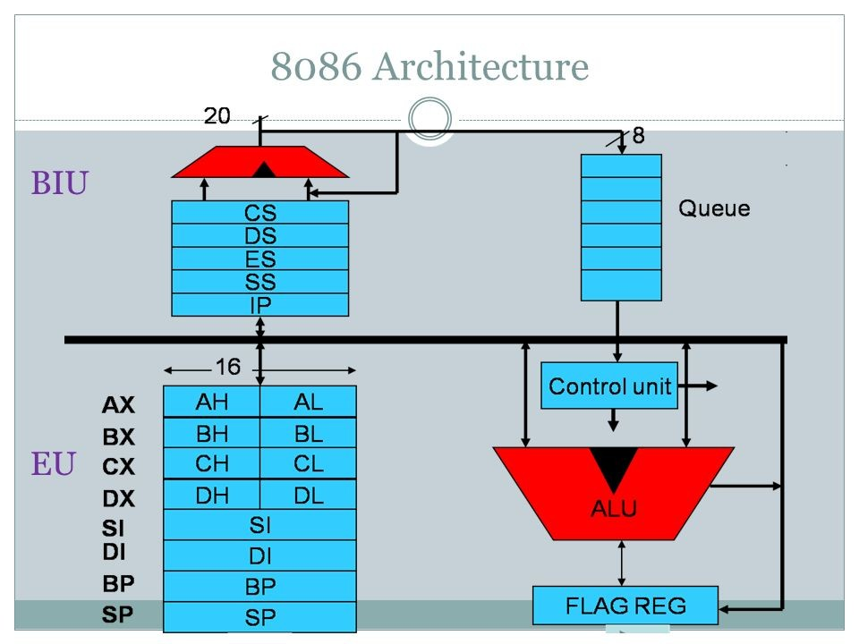
Architecture of 8086

Slide 4
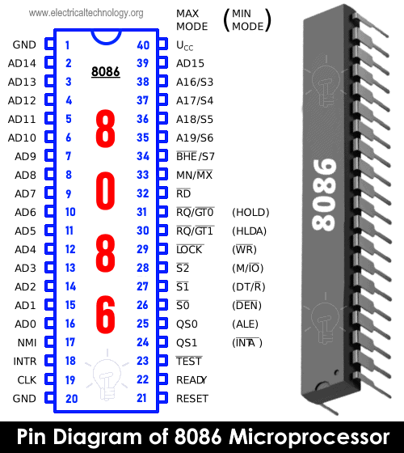
Power Signals
Vcc 5V Power
Ground
Clock

Slide 5
Address/Data Bus
8086 uses a 20-bit address bus and 16-bit data bus
AD0-AD15 - Multiplexed Address/Data Bus 16-bits
A16/S3, A17/S4, A18/S5, A19/S6 - Multiplexed Higher Order Addresses and Status Signals
Bus High Enable, to enable the transfer of higher order data bits D8-D15
ALE - Address Line
Enable (1 - Address, 0 - Data)

Slide 6
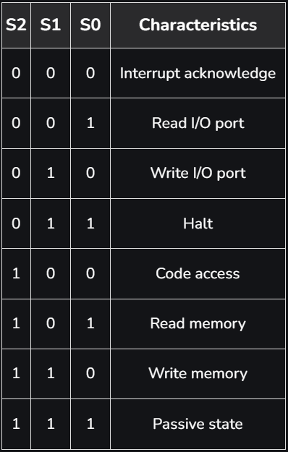
Status Pins
Minimum/ Maximum Mode

Slide 7
Interrupts
There are mainly 2 types of interrupts: Hardware Interrupts - Hardware interrupts are those interrupts that are caused by any peripheral device by sending a signal through a specified pin to the microprocessor.
Software Interrupts - These are instructions inserted within the program to generate interrupts. There are 256 software interrupts in the 8086 microprocessor. The instructions are of the format INT type, where the type ranges from 00 to FF.

Slide 8
Interrupts
Non Maskable Interrupts (Highest Priority Interrupts)
Interrupt Request (I/0)
Memory / IO
Data Transmit / Receive
Data Enable
Interrupt Acknowledge

Slide 9
Hello World in 8086
org 100h
jmp start ; jump over data declaration
msg: db "Hello, World!", 0Dh,0Ah, 24h
start: mov dx, msg ; load offset of msg into dx.
mov ah, 09h ; print function is 9.
int 21h ; do it!
mov ah, 0
int 16h ; wait for any key....

Slide 10
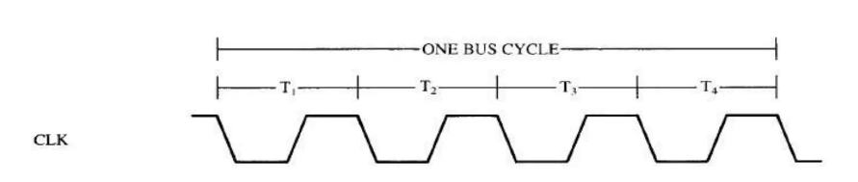
Bus Cycles of 8086
A bus cycle also called as a machine cycle is used to access memory, peripheral devices (I/O), and Interrupt controller. Bus cycle corresponds to a sequence of events that starts with an address being output on system address bus followed by a write or read data transfer.
During these operations, a series of control signals are also produced by microprocessor to control direction and timing of bus. There are at least four clock periods in a bus cycle of 8086 microprocessor.

Slide 11
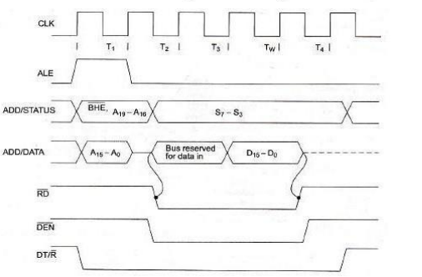
Read Cycle of 8086
T1: Address of the memory or I/O location is sent out via the address bus.
Control signals like ALE, DT/R, M/IO are also set.
T2: RD signal, DEN signals
We check the READY signal at end of T2, if low then T3 is a wait state
T3: If the READY signal is set, then we perform the read from memory
T4: Bus signals deactivated in preparation of next bus cycle.

Slide 12
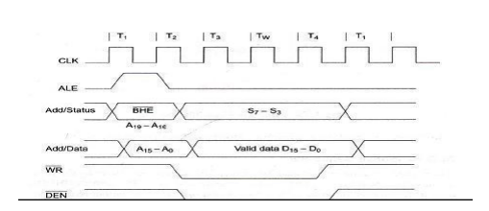
Write Cycle of 8086
T1: Address of the memory or I/O location is sent out via the address bus.
Control signals like ALE, DT/R, M/IO are also set.
T2: WR signal, DEN signals
Data is written to Memory
T4: Bus signals deactivated in preparation of next bus cycle.

Slide 13

Instruction Cycle of 8086

Slide 14
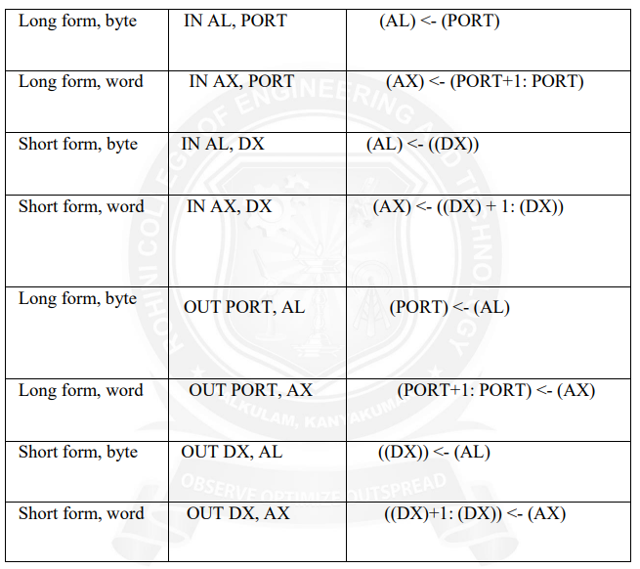
I/O Programming in 8086
On 8086, all programmed communications with I/O ports is done by the IN and OUT instructions. All I/O Operations are performed on ports, ports range from 0 to 255. Example:
IN AX, 28h ; Data at port 28 is moved into AX
MOV DATA_WORD, AX ; Data at AX is moved into memory location denoted by DATA_WORD
Notes:
When we use DX, register is used as port so we can access ports upto 64K

Slide 15
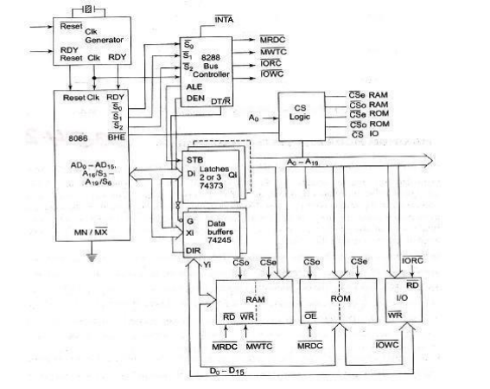
System Design Using 8086: Maximum Mode
Maximum mode is operated by strapping the MN/MX pin to ground. In this mode, processor derives status signals S2, S1, S0, Bus Controller derives control signals based on status information. We can have more than one microprocessor in the system configuration.

Slide 16
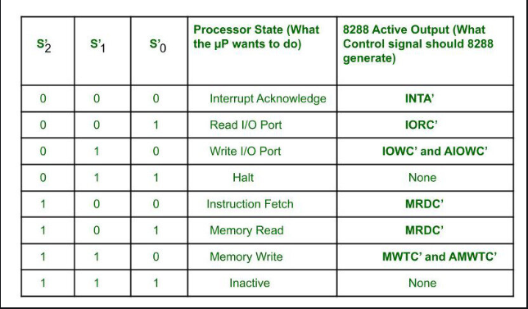
Status Signals Maximum Mode

Slide 17
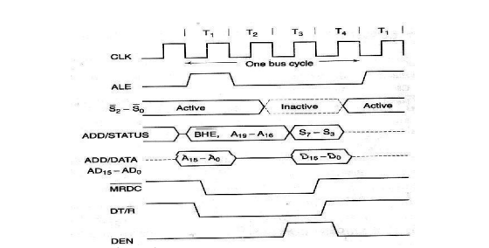
Read Cycle of 8086 in Maximum Mode
T1: Address of the memory or I/O location is sent out via the address bus.
Control signals like ALE, DT/R, M/IO are also set. MRDC is set
T2: RD signal, DEN signals
We check the READY signal at end of T2, if low then T3 is a wait state
T3: If the READY signal is set, then we perform the read from memory
T4: Bus signals deactivated in preparation of next bus cycle.

Slide 18
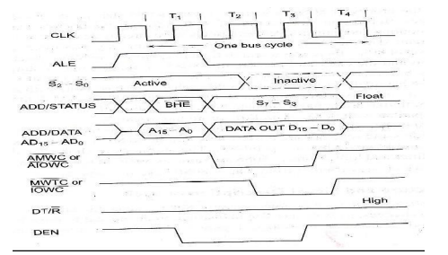
Write Cycle of 8086 in Maxmimum Mode
T1: Address of the memory or I/O location is sent out via the address bus.
Control signals like ALE, DT/R, M/IO are also set.
T2: WR signal, DEN signals
Data is written to Memory
T4: Bus signals deactivated in preparation of next bus cycle.

Slide 19
MultiProcessor Systems
Multiprocessor systems refers to the use of multiple processors that execute instructions simultaneously and communicate using mailboxes or semaphores.
Maximum Mode in 8086 is designed to implement 3 configs:
CoProcessor(8087)
Closely Coupled (dedicated I/O Processor: 8089)
Loosely Coupled (Multibus)
Coprocessor and Closely Coupled Processors are very similar, they share Memory, I/O and Bus.

Slide 20
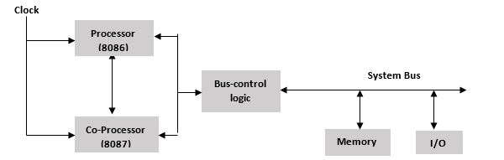
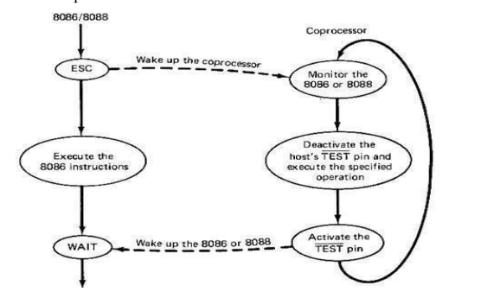
CoProcessor
8087 is a Math Co-Processor. We use the ESC instruction to communicate with 8087 Like ESC opcode, operand

Slide 21
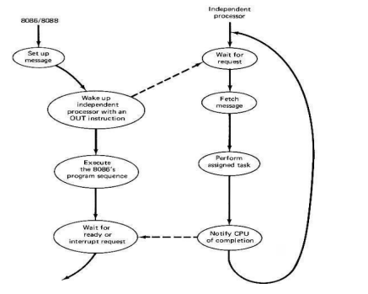
Closely Coupled Processor
Communication is via shared memory
Coprocessor cannot take control of the bus, it does everything through the CPU

Slide 22
Loosely Coupled Processors
We can achieve high system throughput by having more than one CPU.
Can have a modular design with independent system bus modules.
Failure in one module does not cause a breakdown of the system (fault-tolerant).
We need extra bus access logic to control which CPU has access to the bus at a given point in time, we use 3 priority based strategies:
Daisy Chaining
Polling
Independent Requesting

Slide 23
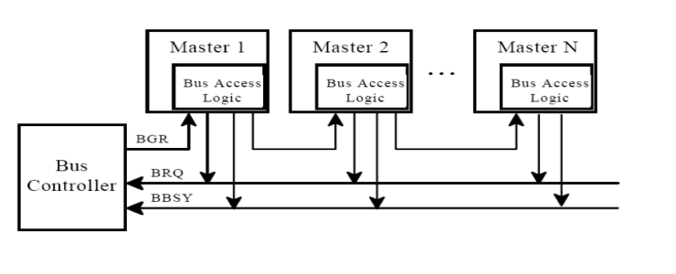
Daisy Chaining
We use a bus controller to monitor bus busy and bus request signals.
Sends bus grant to each bus master, and then master decides to keep it or pass it to the next master.
Controller does clock synchronization.

Slide 24
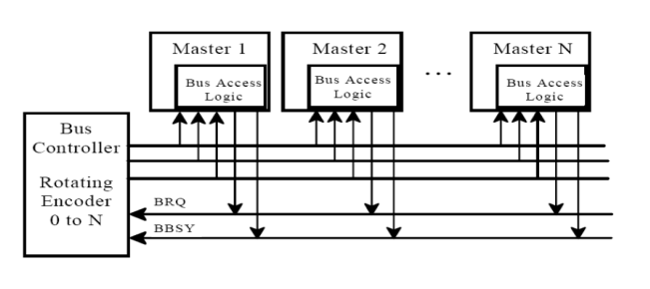
Polling
Controller sends address of device to grant bus access.
We can use priority resolution here:
Highest priority is granted first, then we move to lower priorities.

Slide 25
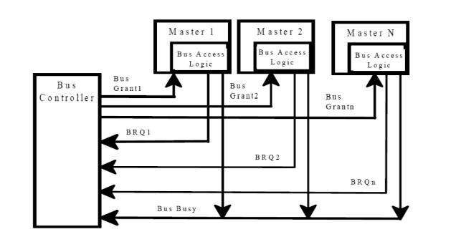
Independent Requests
Each master has a request and grant line.
Each pair has a priority assigned to it.
Controller includes a priority decoder, which selects the request with the highest priority and returns the corresponding grant signal. Priority can be fixed or rotating priority

Slide 26
Advanced Processors: 80286
Advanced Memory Management and Protection Capabilities.
24-bit address bus capable of addressing 16MB of Physical Memory. In Real Mode, it can access upto 1MB of physical memory. In Virtual Address Mode, it can access upto 16MB of Physical and upto 1GB of virtual memory.

Slide 27
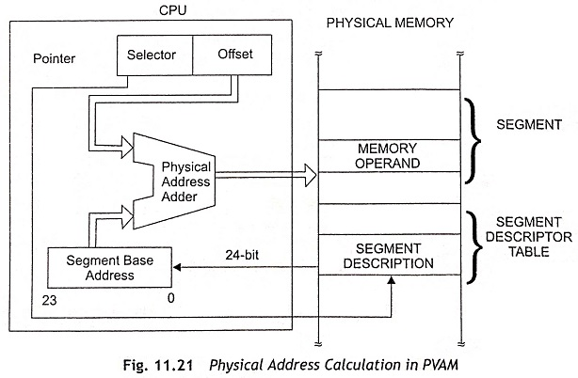
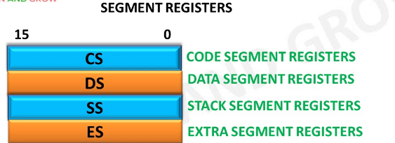
What is Virtual Memory?
Memory Management technique that allows the processor to address more memory than is physically available in the system’s RAM. ( 2 ^ 24 = 16MB)
How is it achieved in the context of 80286? Segmentation

Slide 28
Thank you
Questions?

